Slide 1
Mottled Stars
How Does Starspot Coverage Affect Stellar Brightness Variability?
Miles L. Johnson

Slide 2
WHAT IS A STARSPOT?
Starspots or sunspots are dark blotches on the surface of stars (Gough 2010).
First studied in the west when Galileo Galilei and Thomas Harriot first used telescopes to observe the Sun (Gough 2010).
What causes these blemishes and their affects on the host star are not well understood.
Thought to be caused by magnetic disturbances beneath the stellar surface (Gough 2010).

Slide 3
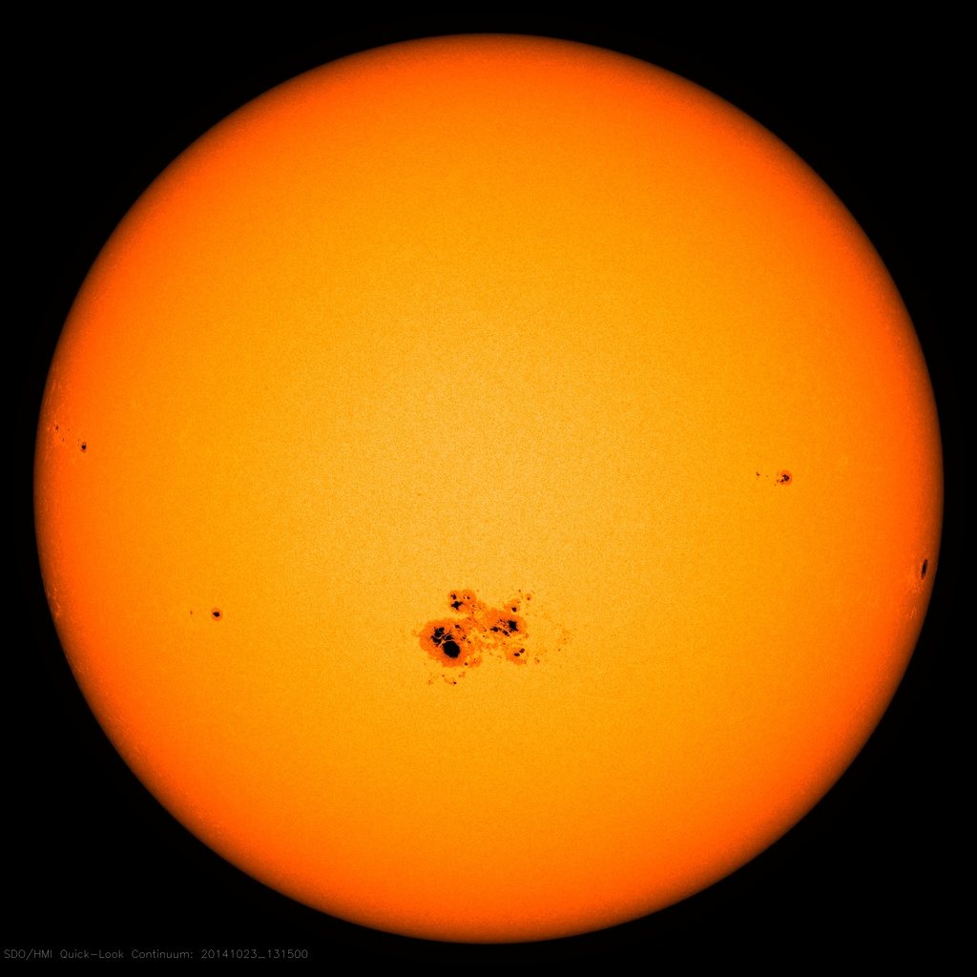
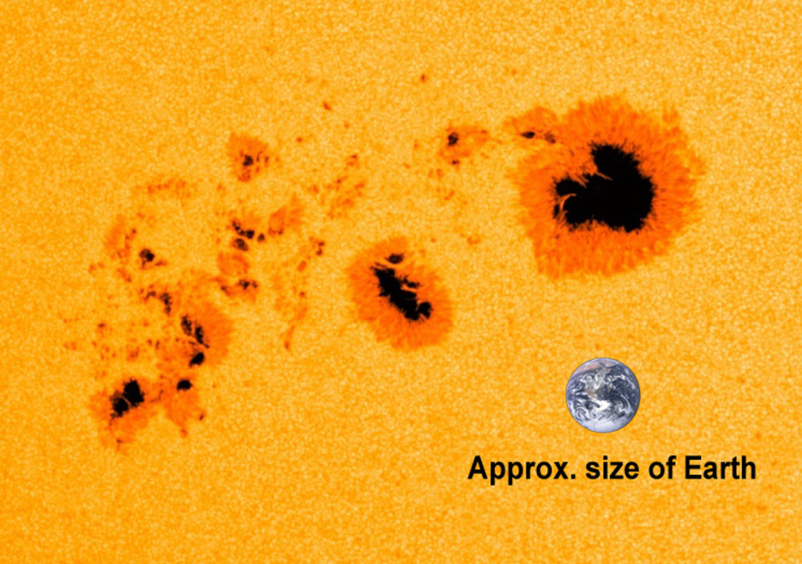
Sunspots
Image Credit: NASA/SDO
Image Credit: NASA/SDO

Slide 4
MOTTLED Stars project

